Slide 1
DATA-DRIVEN MODELS FOR THE CLIMATE VARIABLES ANALYSIS AND PREDICTION: A CASE STUDY OF SOIL MOISTURE
2019 DATA SCIENCE FELLOWSHIP
Kim-Ndor Djimadoumngar

Slide 2
INTRODUCTION
Predicting Soil Moisture gives:
More precised and accurate estimation of water balance of a spring catchment and reservoir
More precised recharge time of surface water (e.g. lakes, rivers) and groundwater (aquifer: Ogallala)
Extremely important for decision-makers
Agricultural economy, other socio-economic and environmental water related issues

Slide 3
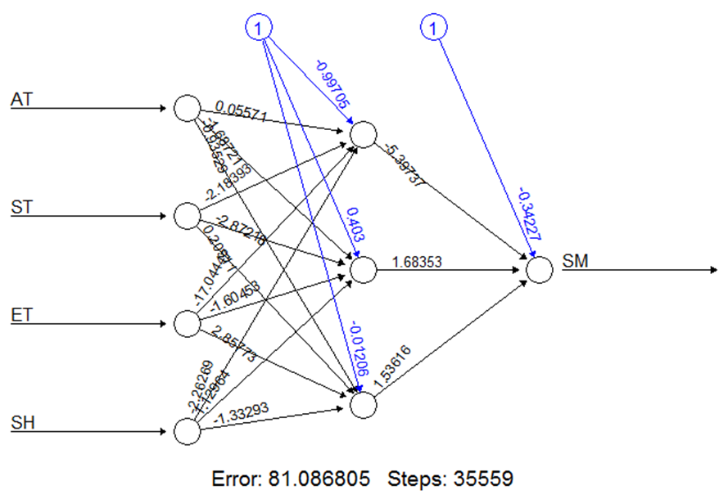
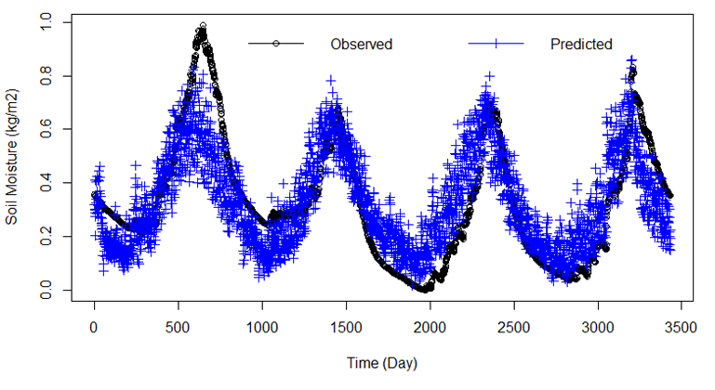
Memorable Takeaways
Technical Takeaway
Artificial Neural Network
R-squared
Linear Regression
r = 0.7669305 -> R² = 0.5881 = 58.81%
R-squared: 0.4619 = 46.19%
R² improved by
Percentage Increase = (0.58818239183025 - 0.4619)/ 0.4619 = 0.27339768744371075990474128599264 *100 = 27.33%

Slide 4
Memorable Takeaways
Technical Takeaway
Mean Squared Error
Artificial Neural Network
Linear Regression
NN_Error = 0.02049122
LM_MSE = 0.02075518
0.02049122 - 0.02075518/ 0.02049122 = - 0.01288161466227974713072232888037 * 100
= -1.2881614662279747130722328880369 %
0.02075518 - 0.02049122 - / 0.02075518 = 0.01271778900496165294639699583429 * 100
= 1.2717789004961652946396995834293 %
MSE improved by 1.27%

Slide 5
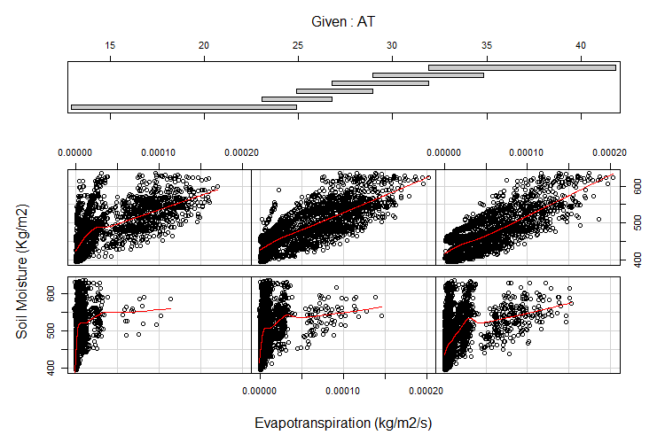
Memorable Takeaways
Fun Facts Takeaway
coplot(SM~ET|AT, panel = panel.smooth, ylab ="Soil Moisture (Kg/m2)", xlab = "Evapotranspiration (kg/m2/s)", data = mydata)
r(SM, AT) = -0.1960977
r(SM, ET) = 0.4107985
r(AT, ET) = 0.4041305

Slide 6
METHODOLOGY
R
Data analyze: 1 MB of environmental data
Exploratory Data Analysis
Best Subset Selection using
Artificial Neural Network (ANN) using neuralnet package
Model accuracy: Linear Model vs Comparison ANN.
k-Fold Cross-Validation ( k-fold CV) using boot package
Root Mean Squared Error (RMSE)

Slide 7
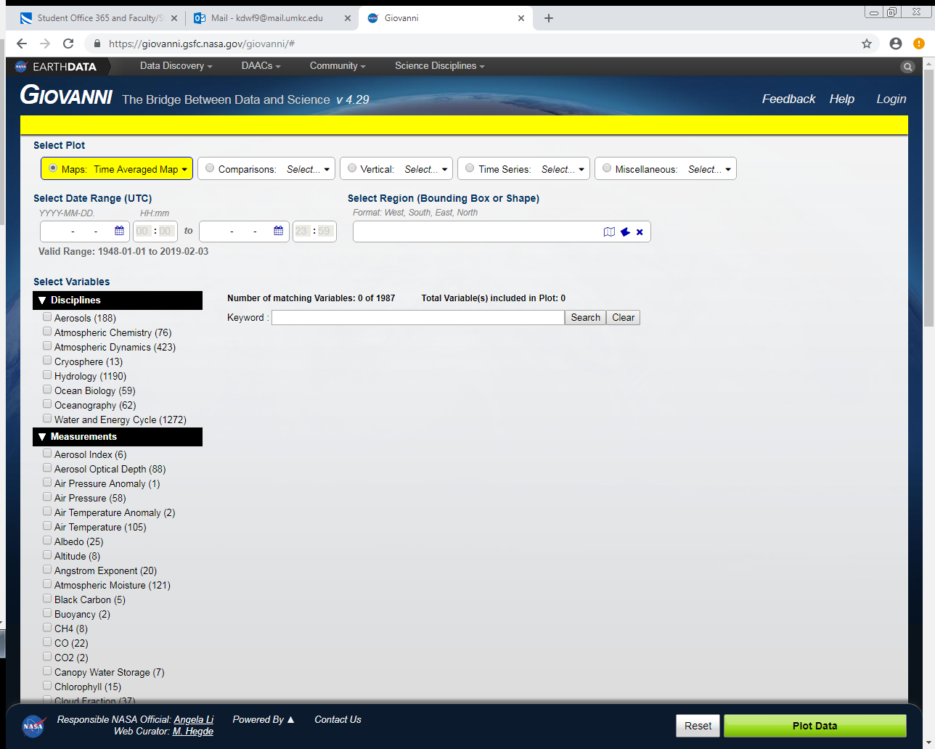
DATA SOURCE AND DATASET
https://giovanni.gsfc.nasa.gov/giovanni/
11440 observations 7 variables
Total size on disk: 1 MB

Slide 8
FUTURE WORK
Trigonometric Regression
To assess the impact the variable Time because of the seasonality
Models of increasing complexity to evaluate the impact of each variable

Slide 9
REFERENCE
Gareth J., Witten D., Hastie T. and Tibshirani R. (2013). An introduction to statistical learning with applications in r. ISBN 978-1-4614-7138-7 (eBook) Springer.
Hiroko, B., and Rodell, M., NASA/GSFC/HSL (2015). GLDAS Noah Land Surface Model L4 monthly 1.0 x 1.0 degree V2.0, Greenbelt, Maryland, USA, Goddard Earth Sciences Data and Information Services Center (GES DISC) at 10.5067/QN80TO7ZHFJZ [accessed on December 12, 2018].
Rodell, M., P.R. Houser, U. Jambor, J. Gottschalck, K. Mitchell, C. Meng, K. Arsenault, B. Cosgrove, J. Radakovich, M. Bosilovich, J.K. Entin, J.P. Walker, D. Lohmann, and D. Toll, (2004). The global land data assimilation system, Bull. Amer. Meteor. Soc., 85, 381-394, doi:10.1175/BAMS-85-3-381.
Tropical Rainfall Measuring Mission, TRMM (2011). TRMM Microwave Imager Precipitation Profile L3 1 month 0.5 degree x 0.5 degree V7, Greenbelt, MD, Goddard Earth Sciences Data and Information Services Center (GES DISC) at https://disc.gsfc.nasa.gov/datacollection/TRMM_3A12_7.html [accessed on December 15, 2018].

